Slide 1
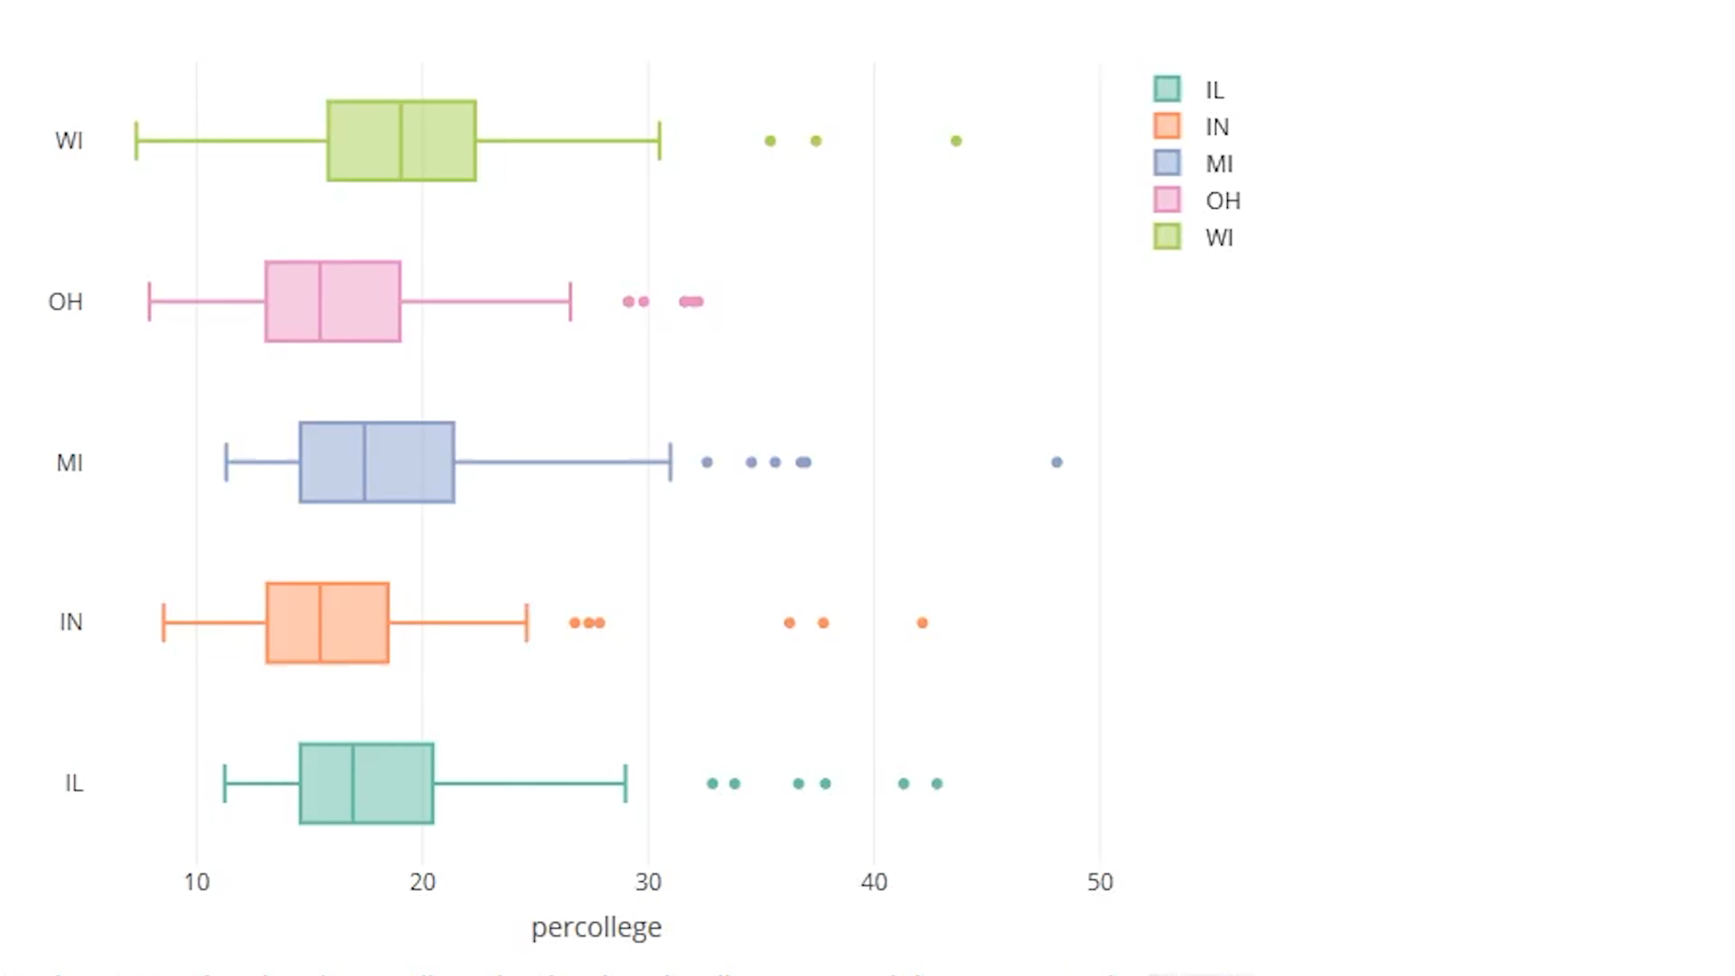
R Programming – Plotly Package
By Joshua Yang
Summary of Plotly:
- Used for creating interactive web based graphs
- Runs locally in your web browser or RStudio viewer
- Graphs with Plotly R package are interactable
Rendered locally through the HTML widgets framework
Good data representation for visual appearance
Data Research (Geography, Earth Science, active data graph(radar), etc.)
Helps with external packages (dplyr example)

Slide 2
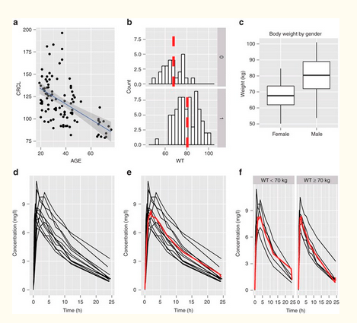
Basic Infrastructures:
2x Functions to create data graphic
Original was to provide transition from R to Plotly
Layers and Aesthetic Mapping
- Composed of one or more layers
- Each layers contains a different graphical object
Requires two Optimal Arguments
- Data (Input data frame)
- AES, which defines “x” and “y” variable

Slide 3
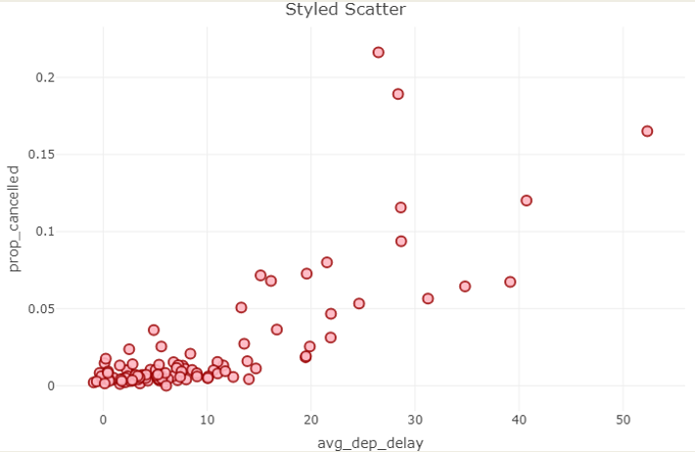
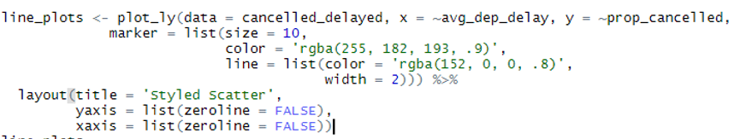
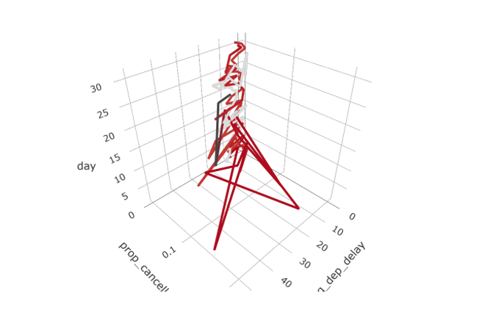
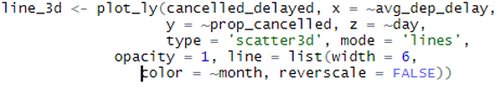
Examples:
Creating a Scatter Styled Plot
ggplot(data = Data, aes(x,y))
Standard Call for 3d Plotting

